Slide 1

Thesis Seminar On
Crop Monitoring & Classification using Machine Learning Algorithm
-: Prepared By :-
Pratik Akbari
Himanshu Dadhaniya
Brijesh Jethva
-: Under the Guidance :-
of
Prof. G. D. Gohil
College of Agricultural Engineering & Technology
Junagadh Agricultural University
Junagadh - 362001

Slide 2
Topics to be Covered
01 - Objectives
02 - Introduction
03 - Review of Literature
04 - Materials and Methods
05 - Result and Discussion
06 - Conclusion and Summary
07 – References

Slide 3
01
Objectives

Slide 4
JUSTIFICATION
Helpful for Precesion Farming.
Helpful to crop insurance companies to develop better Policies that
are more useful to farmers.
Help for provide near accurate estimate of the area under each crop.
Help in identifying the supply-demand scenario.
System can help in the weed management
We can set irrigation scheduling based on the crop condition.

Slide 5
OBJECTIVE
Collect UAV data for Crop Monitoring.
Determination of NDVI value.
Crop condition assessment based on NDVI value
Crop Classification
Crop Acreage Estimation

Slide 6
Introduction
02
AGRICULTURE IN INDIA
ROLE OF MACHINE LEARNING IN
MODERN AGE AGRICULTURE
TYPES OF MACHINE LEARNING
HOW CAN WE UTILISE ?

Slide 7
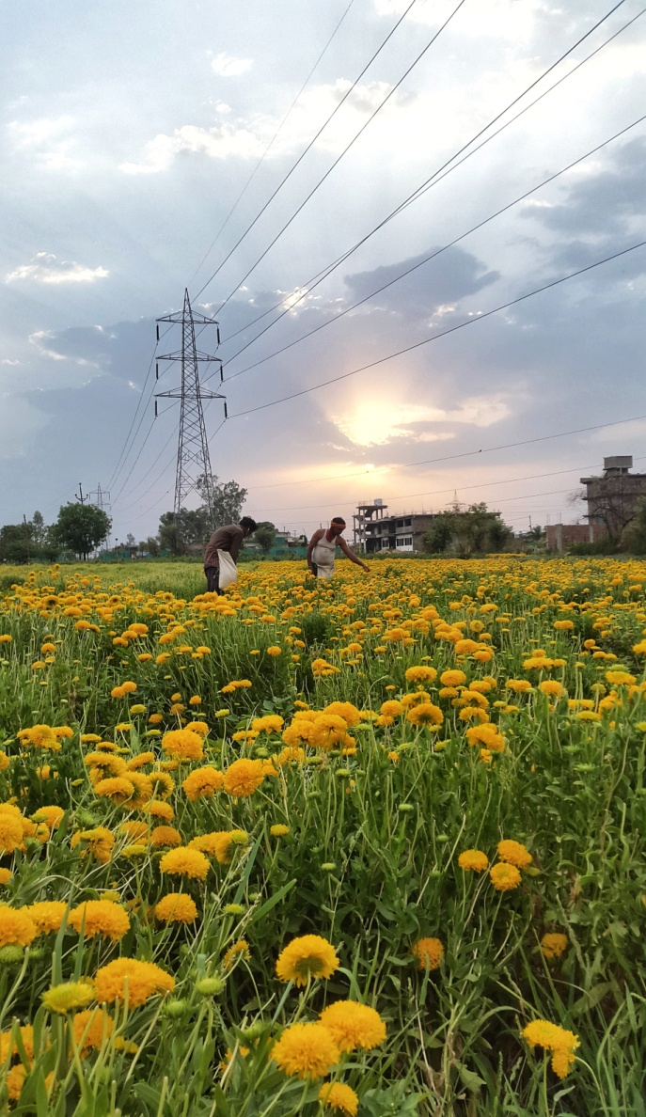
AGRICULTURE IN INDIA
India ranks first in the world with highest net cropped area
followed by US and China.
Agriculture plays a very pivotal role in the global economy of the
country.
Due to the increase in population, there is constant pressure on the
agricultural system to improve the productivity of the crops and to
grow more crops.
Machine Learning (ML) with Artificial Intelligence (AI) is silently but
increasingly entering Indian agriculture and hence affecting our
society at large.

Slide 8
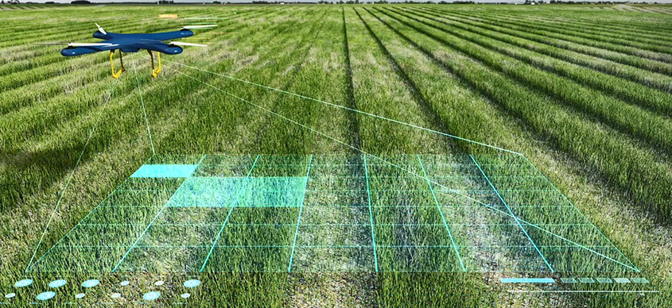
ROLE OF MACHINE LEARNING IN
MODERN AGE AGRICULTURE
To Solve The Problems Faced By The Client
Diversity
In types of plants
Improve the
Productivity of crop
Yield Prediction
Weeds
Identification
To Identify
the Bug Hunters
Precision
farming

Slide 9
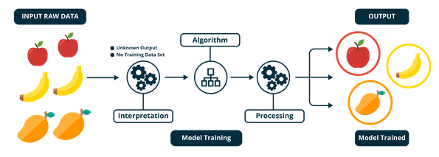
TYPES OF MACHINE LEARNING
1
Supervised Learning

Slide 10
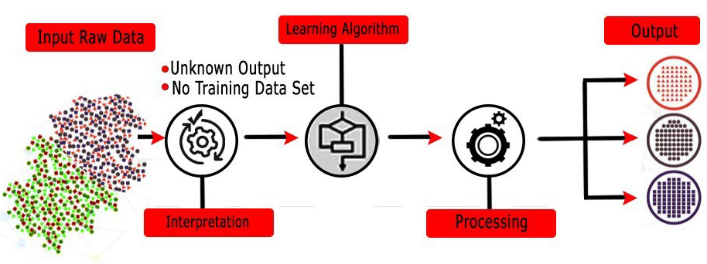
TYPES OF MACHINE LEARNING
2
Unsupervised Learning

Slide 11
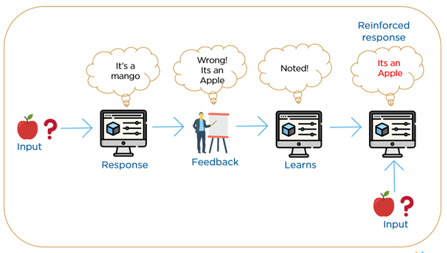
TYPES OF MACHINE LEARNING
3
Reinforcement Learning

Slide 12

HOW MACHINE LEARNING CAN WE UTILISE?
Based On Machine Learning Algorithms
Support vector
Machines (SVM)
Nearest
Neighbor
Neural
Networks (NN)
Regression
Methods
Random Forest
Decision Trees

Slide 13
WHAT IS NDVI ?
NDVI= (NIR-RED) / (NIR+RED)
NDVI value range is between -1 and +1.
-1 to 0 :- Non vegetated area.
0 to 0.25 :- “Poor ” vegetation.
0.25 to 0.50 :- “Medium” vegetation.
0.50 to 0.75 :- “Good” vegetation.
0.75 to 1 :- “Excellent ” vegetation.
Red Reflectance < NIR Reflactance :- This will yield a High NDVI value And
vice versa.
Normalized difference vegetation index

Slide 14
Review of literature
03
IMAGE CLASSIFICATION
ESTIMATION OF NDVI
CROP ACREAGE ESTIMATION

Slide 15
1. Image Classification
Authors :- C.-C. Yang et al. (2000).
The objective of the study was to develop a back-propagation artificial neural network (ANN) model that could distinguish young corn plants from weeds. Although only the colour indices associated with image pixels were used as inputs, it was assumed that the ANN model could develop the ability to use other information, such as shapes, implicit in these data.
Authors :- Nataliia Kussul, et al. (2017).
In this experiments are carried out for the joint experiment of crop assessment and monitoring test site in Ukraine for classification of crops in a heterogeneous environment using nineteen multi temporal scenes acquired by Landsat-8 and Sentinel-1A RS satellites. The architecture with an ensemble of CNNs outperforms the one with MLPs allowing us to better discriminate certain summer crop types, in particular maize and soybeans, and yielding the target accuracies more than 85% for all major crops (wheat, maize, sunflower, soybeans, and sugar beet).

Slide 16
2. Crop Condition Assessment
Authors :- Md. Rejaur Rahman et al. (2004)
In this study the spectral reflectance of a field will vary with respect to changes in the phenology (growth), stage type, and crop health, and thus can be measured and monitored by multispectral sensors. In their study IRS LISS II digital data and NDVI (Normalized difference vegetation index) has been used to identify the sugarcane area and its condition assessment. Ratio image are often useful for discriminating subtle differences in spectral variation in a scene that is masked by brightness variations. For identifying the area and condition of dense crop like sugarcane, NDVI image is often useful because of its canopy cover, crop biomass and vigour. The accuracy achieved was 85.25% for NDVI image of IRS LISS II digital data.
Authors :- R.S. Defries & J.R.G. Townshend (2007)
Explained that phenological differences among vegetation types, reflected in temporal variations in the Normalized Difference Vegetation Index (NDVI) derived from satellite data, have been used to classify land cover at continental scales. For their study, a coarse spatial resolution (one by one degree) data set of monthly NDVI values for 1987 was used to explore these methodological issues. A result of a supervised, maximum likelihood classification of eleven cover types is presented to illustrate the feasibility of using satellite sensor data to increase the accuracy of global land cover information, although the result has not been validated systematically. Satellite sensor data at finer spatial resolutions that include other bands in addition to NDVI, as well as methodologiesto better identify and describe gradients between cover types, could increase the accuracy of results of global land cover data sets derived from satellite sensor data.

Slide 17
3. Crop Acreage Estimation
Authors :- Zhang Fumin et al. (2010)
Crop acreage and yield is of great significance to develop food policies and economic plans for the countries. The development of remote sensing makes possible to achieve the revolutionary development from traditional approach to spatial statistical methods for national statistics. In this paper, they describe the development process of China's crop acreage and yield statistical survey and the international research development in the field. Then, they introduce the application status of crop acreage and yield estimation using remote sensing in China. Finally, they put forward the prospects of the application of remote sensing technology in agricultural survey in China after analyzing deficiencies of current survey system.
Authors :- Abhishek Kumar Maurya (2011)
Focuses on the methodology to map areas of Soybean field with the help of MODIS (TERRA) Satellite data and GIS (Geographical Information System) database using Remote Sensing technique. MODIS (Moderate-Resolution Imaging Spectroradiometer) satellite image offers a large choice of opportunities for operational application in a large area. Study area is selected and located with the help of time series (June 1st week to October 2nd week MODIS Images) which provides maximum accuracy. A concept of assessing areas of potential cultivation of Soybean is suggested by means of GIS technique. Integrating MODIS data with GIS techniques and time series based assessment (June 1st week to October 2nd week) the actual areas of Soybean fields have been mapped and yield production have been predicted. The Soybean acreage area and production accuracy is 80.72% and there is a 7% increase (compared to 2006) in 2007.

Slide 18
Materials And Methods
04
DATA COLLECTION
CROP CONDITION ASSESSEMENT
CROP ACREAGE ESTIMATION
CROP CLASSIFICATION

Slide 19



SOFTWARE USED
Anaconda Spyder 3.7 Platform is Used to Define,compile and Evaluate the Machine learning
Algorithms coded in python
Language.
DroneDeploy is widely used
for flight planning and image merging.
DroneDeploy
QGIS 3.8
Spyder 3.7
QGIS
For Image Preprocessing
Clipping
Band preparation
Band extraction
(Multi-spectral image in
to separate band).

Slide 20
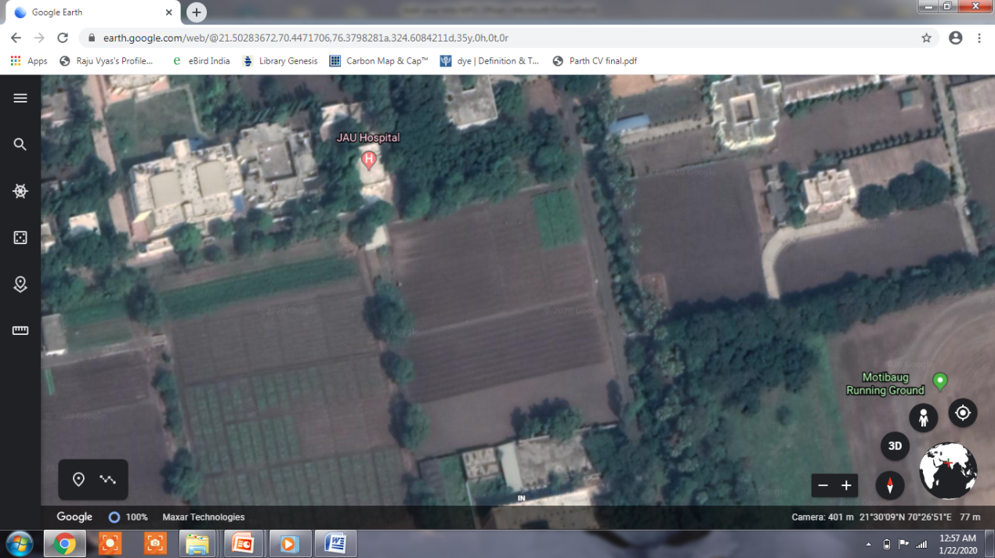
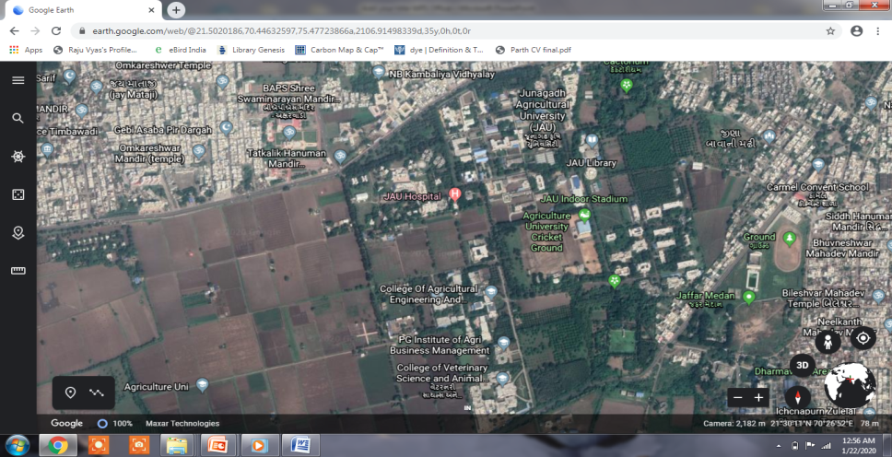
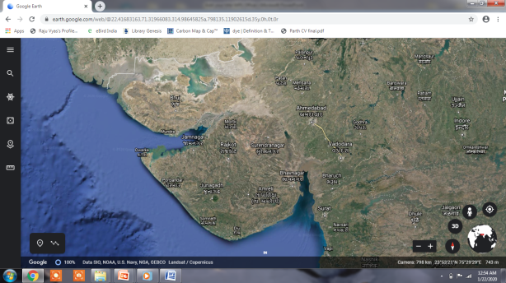
STUDY AREA
GUJARAT JUNAGADH STUDY FIELD

Slide 21
DATA COLLECTION
UAV(DJI Phantom 4 Drone) is used for Image capturing purpose.
Sentera Double 4K Multispectral Sensor attached with Drone to capture NIR band.
Flight planning, Image Mosaicing is done in DroneDeploy Software.
File format of image is GeoTiff.
Data is collected on 21 January 2020.
A Research farm in Junagadh district is selected as a study area.

Slide 22
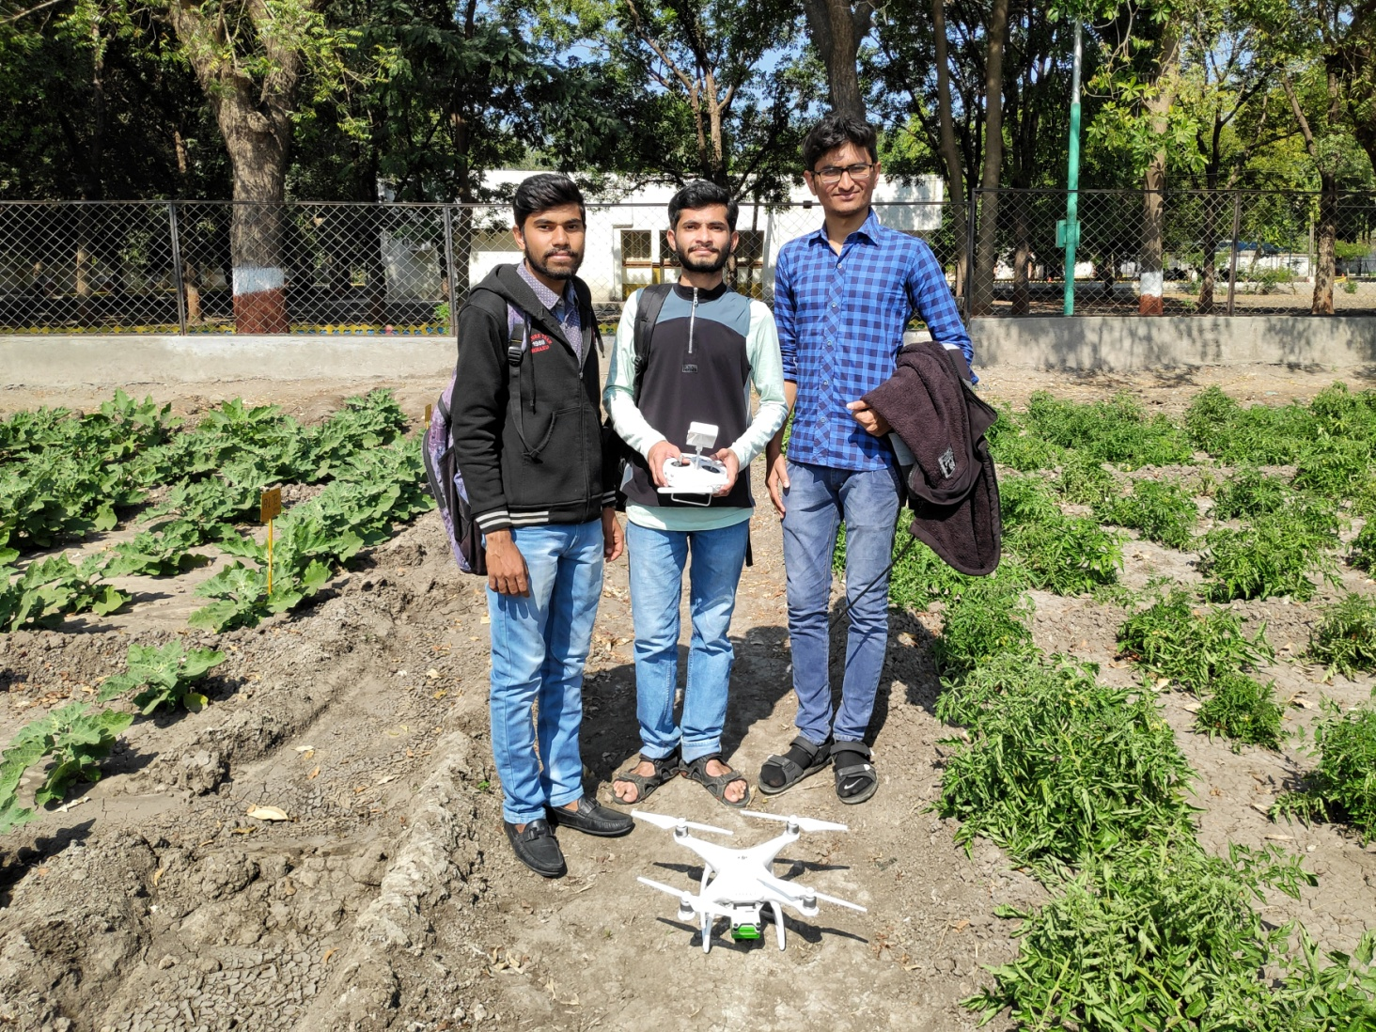
DATA COLLECTION

Slide 23
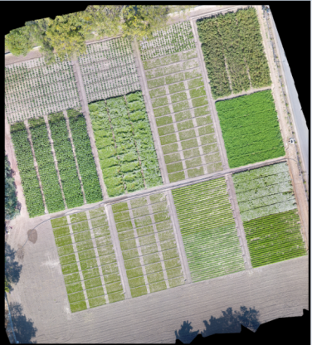
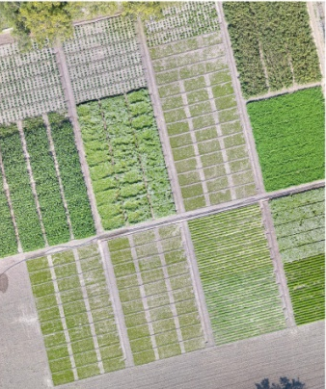
IMAGE PRE-PROCESSING
1
Image Clipping
Clip by Layer Extent Tool in QGIS Software is used for Extract the Area of Interest from the Raw data.

Slide 24
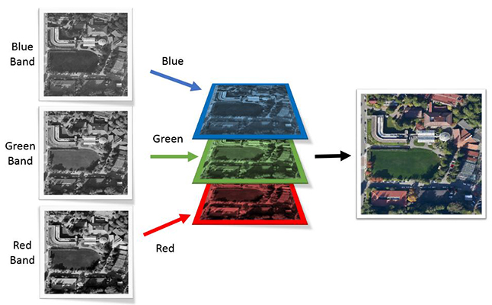
IMAGE PRE-PROCESSING
2
Band Extraction
Clipped Multispectral image contains different Bands (Red, Green, Blue).
This Bands are Separated in QGIS Software using “Split RGB Bands” Tool.
This Bands are further Processed for band Preparation.

Slide 25
IMAGE PRE-PROCESSING
3
Band Preparation
NIR and RED Band Preparation are required for calculate the NDVI value.
NIR Band Prepared from Blue Channel and Red Channel of Raw data using
equation in Ratser Calculator in QGIS.
NIR = 4.350 * DN_{blue} - 0.286 * DN_{red}
RED Band Prepared from Blue Channel and Red Channel of Raw data using
equation in Ratser Calculator in QGIS.
Red = - 0.966 * DN_{blue} + 1.000 * DN_{red}

Slide 26
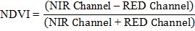
ESTIMATION OF NDVI
Among the several vegetative indices the NDVI is most effective index to
estimate the condition of crop.
Estimation of the NDVI by equation using Python Language as given below,
The Crop leaf reflects the NIR waves according to the amount of the
chlorophyll Pigment
The NDVI value varies between -1 to +1 according to reflecting value, and
crop condition can be classified in to required classes.

Slide 27
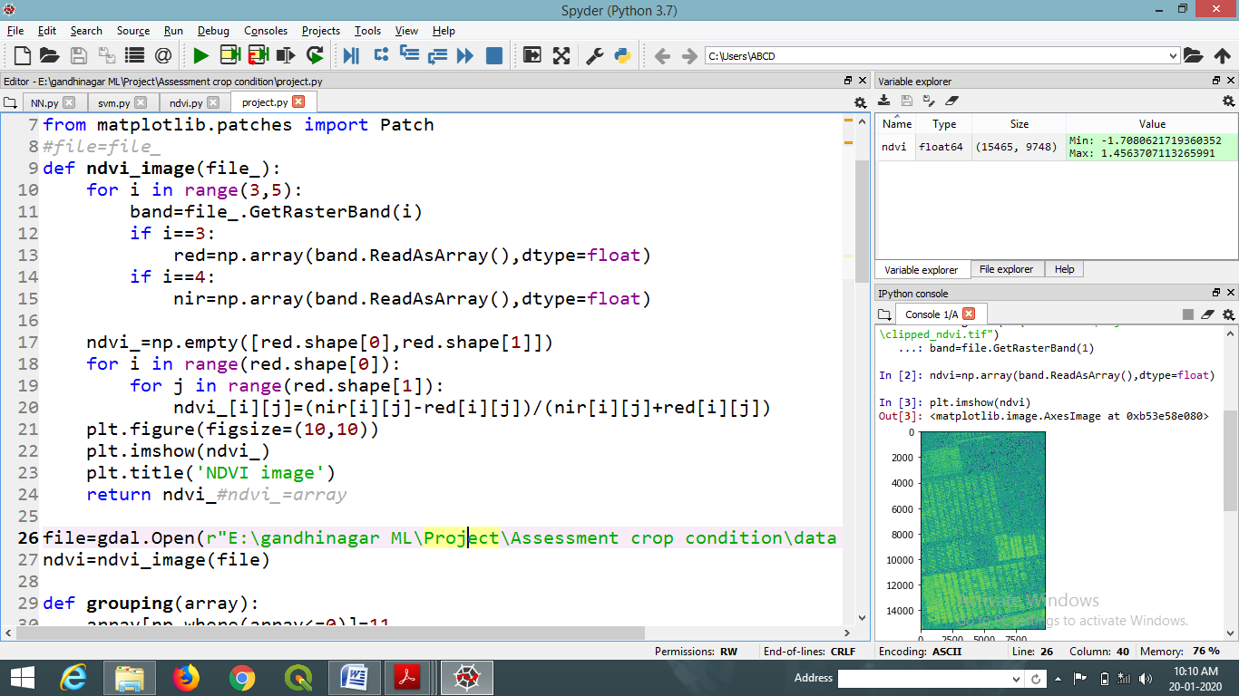
PYTHON CODING FOR NDVI CALCULATION

Slide 28
CROP CONDITION ASSESEMENT
Crop condition based on the range of NDVI value as below:
NDVI < 0 (non-vegetation area)
NDVI = 0 - 0.25 (poor crop)
NDVI = 0.26 – 0.50 (medium crop)
NDVI = 0.51 – 0.75 (good crop)
NDVI > 0.76 (excellent crop)

Slide 29
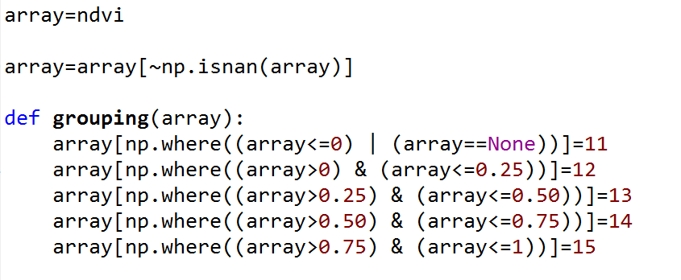
PYTHON CODING FOR GROUPING OF NDVI VALUE

Slide 30
CROP ACREAGE ESTIMATION
Calculate the no. of pixels of condition of crop.
The area covered by each condition of crop in classified NDVI can be
expressed as below :
Acreage = (No. of pixels of crop class) * (Image pixel resolution)

Slide 31
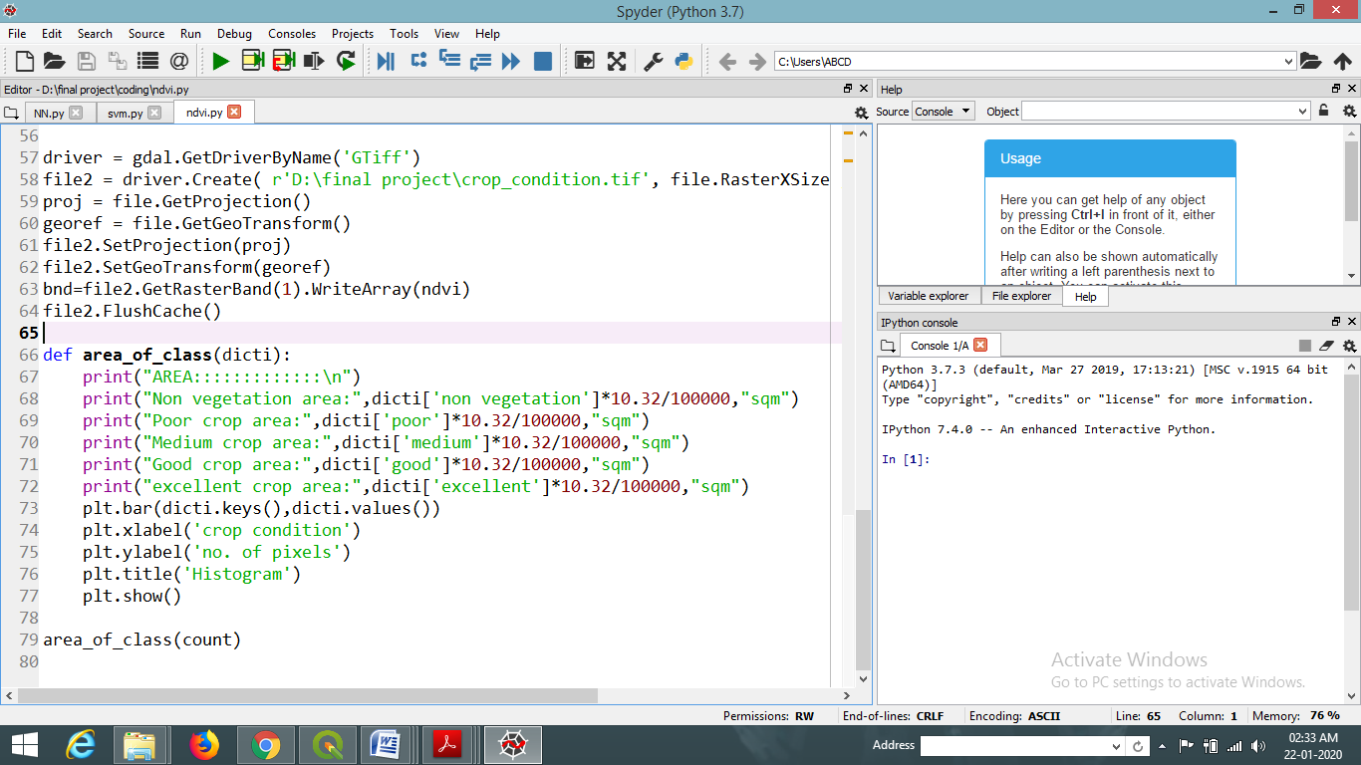
PYTHON CODING FOR ACREAGE ESTIMATION

Slide 32
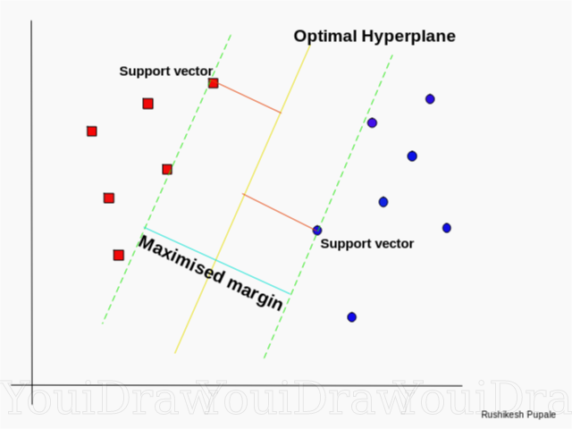
1 ) SUPPORT VECTOR MACHINE (SVM)
SVM constructs a hyperplane or set of hyperplanes in a high dimensional space,
which can be used for supervised classification, regression, or other tasks.
SVM simultaneously minimize the classification error and maximize the geometric margin.

Slide 33
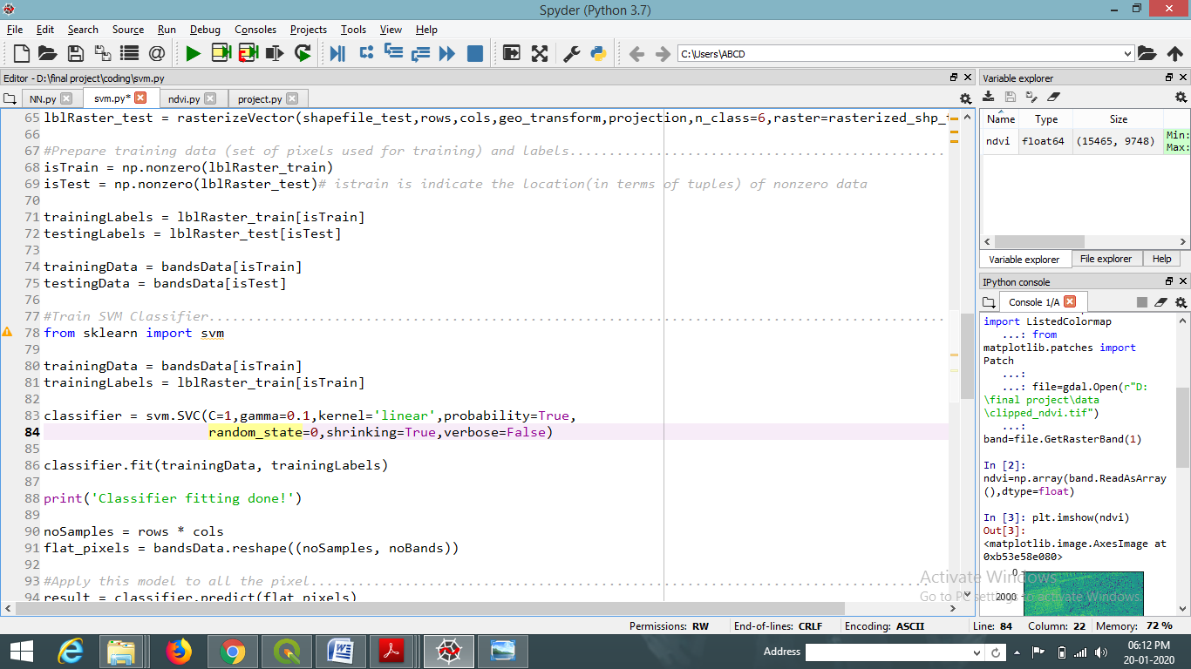
PYTHON CODING FOR SVM CLASSIFIER

Slide 34
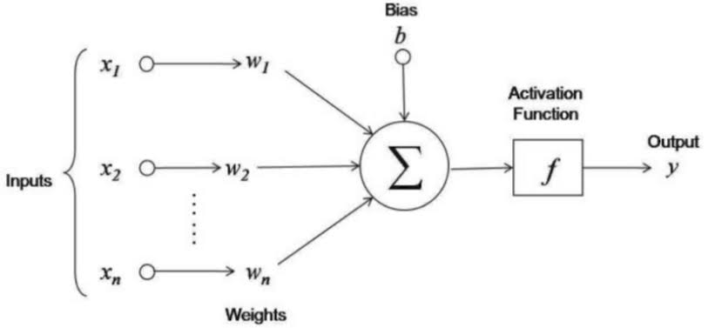
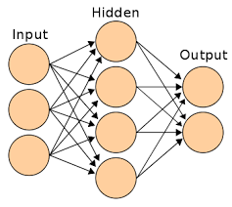
2) NEURAL NETWORK (NN)
NN are supervised models that are typically used for regression and classification
problems.

Slide 35
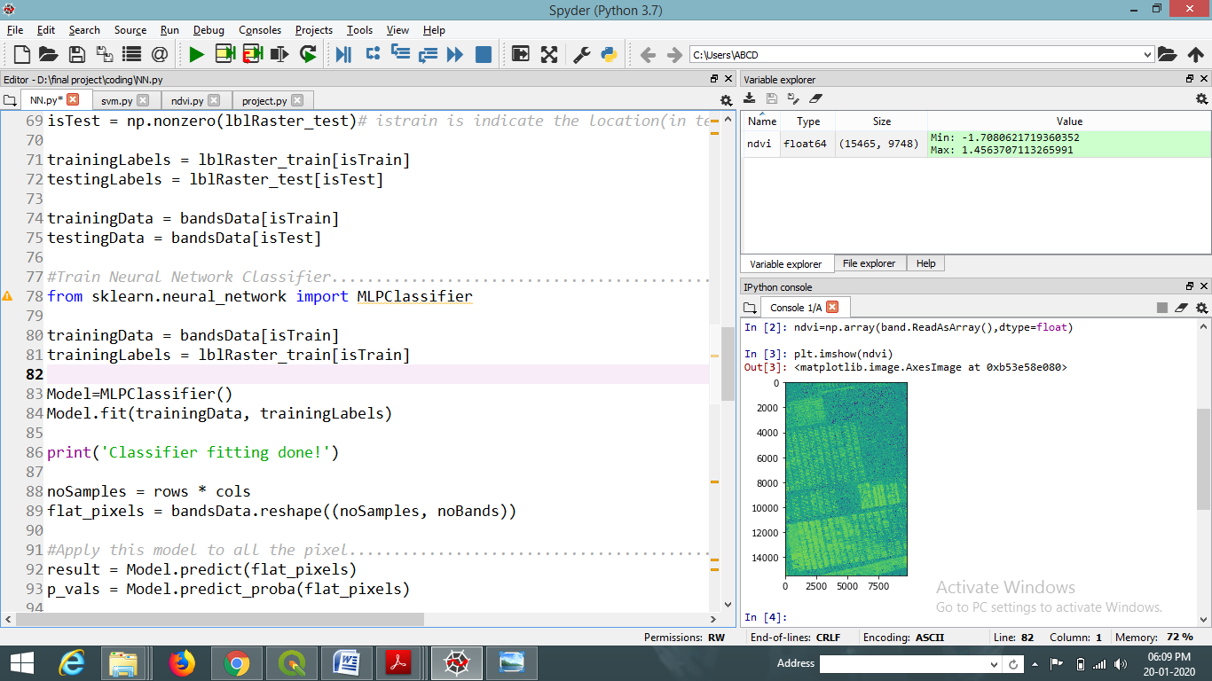
PYTHON CODING FOR NN CLASSIFIER

Slide 36
Results And Discussion
05
UAV DATA OUTPUT
CROP CONDITION ASSESSEMENT
CROP ACREAGE ESTIMATION
CROP CLASSIFICATION

Slide 37
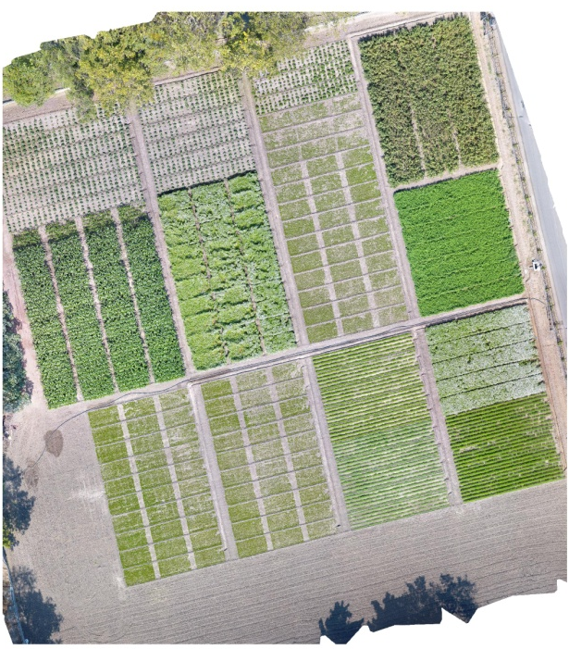
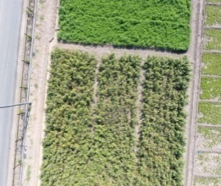
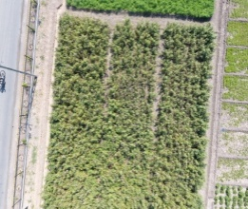
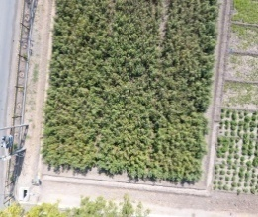
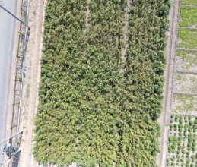
UAV DATA OUTPUT
Drone capture the fragmented images of field, which is merged by DroneDeploy.
That is later on clipped, extracted and re-prepared in QGIS to remove the
Unwanted destortion
Drone output
Merged image
Spatial Resolution : 0.4 inch/pixel
No.of bands : 3 ( Red, Green, Blue)

Slide 38
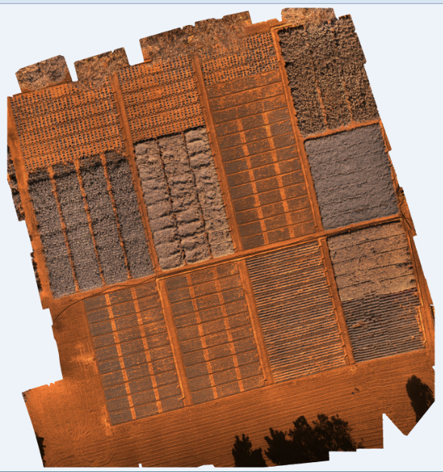
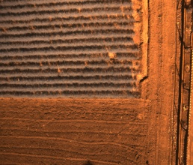
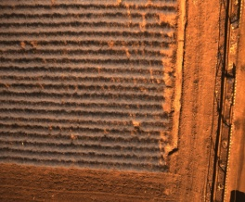
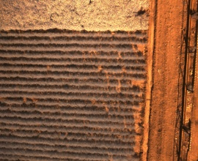
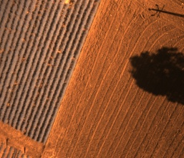
UAV DATA OUTPUT
Similarly Multispectral sensor gives NIR band and NDVI map
Drone Output
Merged Image
Spatial Resolution : 0.4 inch/pixel
No.of bands : 3 ( Red, Green, Blue)

Slide 39
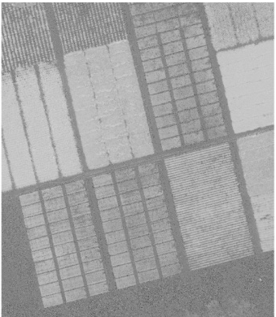
CROP CONDITION
The NDVI map is prepared by using NIR and Red band by band ratioing equation
To assess the condition of crop health, NDVI value has been classified in to several classes.
NDVI value Range = (-1 to +1)

Slide 40
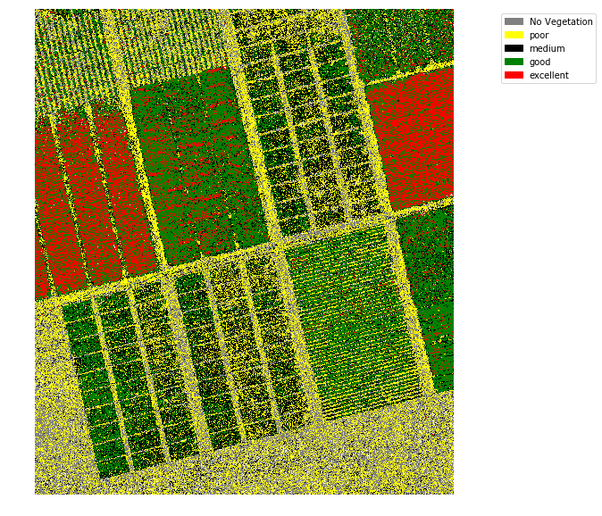
Classified NDVI Image
based on condition

Slide 41
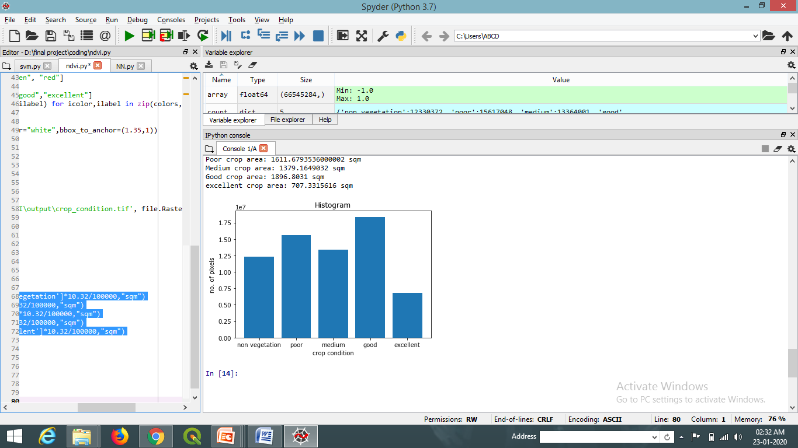
CROP ACREAGE ESTIMATION
The area covered according to condition of crop is determined by
Acreage = (No. of pixels of crop class) * (Image pixel resolution)
Overall Crop Condition in the Study Area
Histogram of crop condition range and No. of pixels

Slide 42
CROP CLASSIFICATION
Crop Classification is done using Supervised Classification
technique in two model as below
Support Vector Machine
Neural Network
For that training and testing samples are given in the form of polygon feature in QGIS

Slide 43
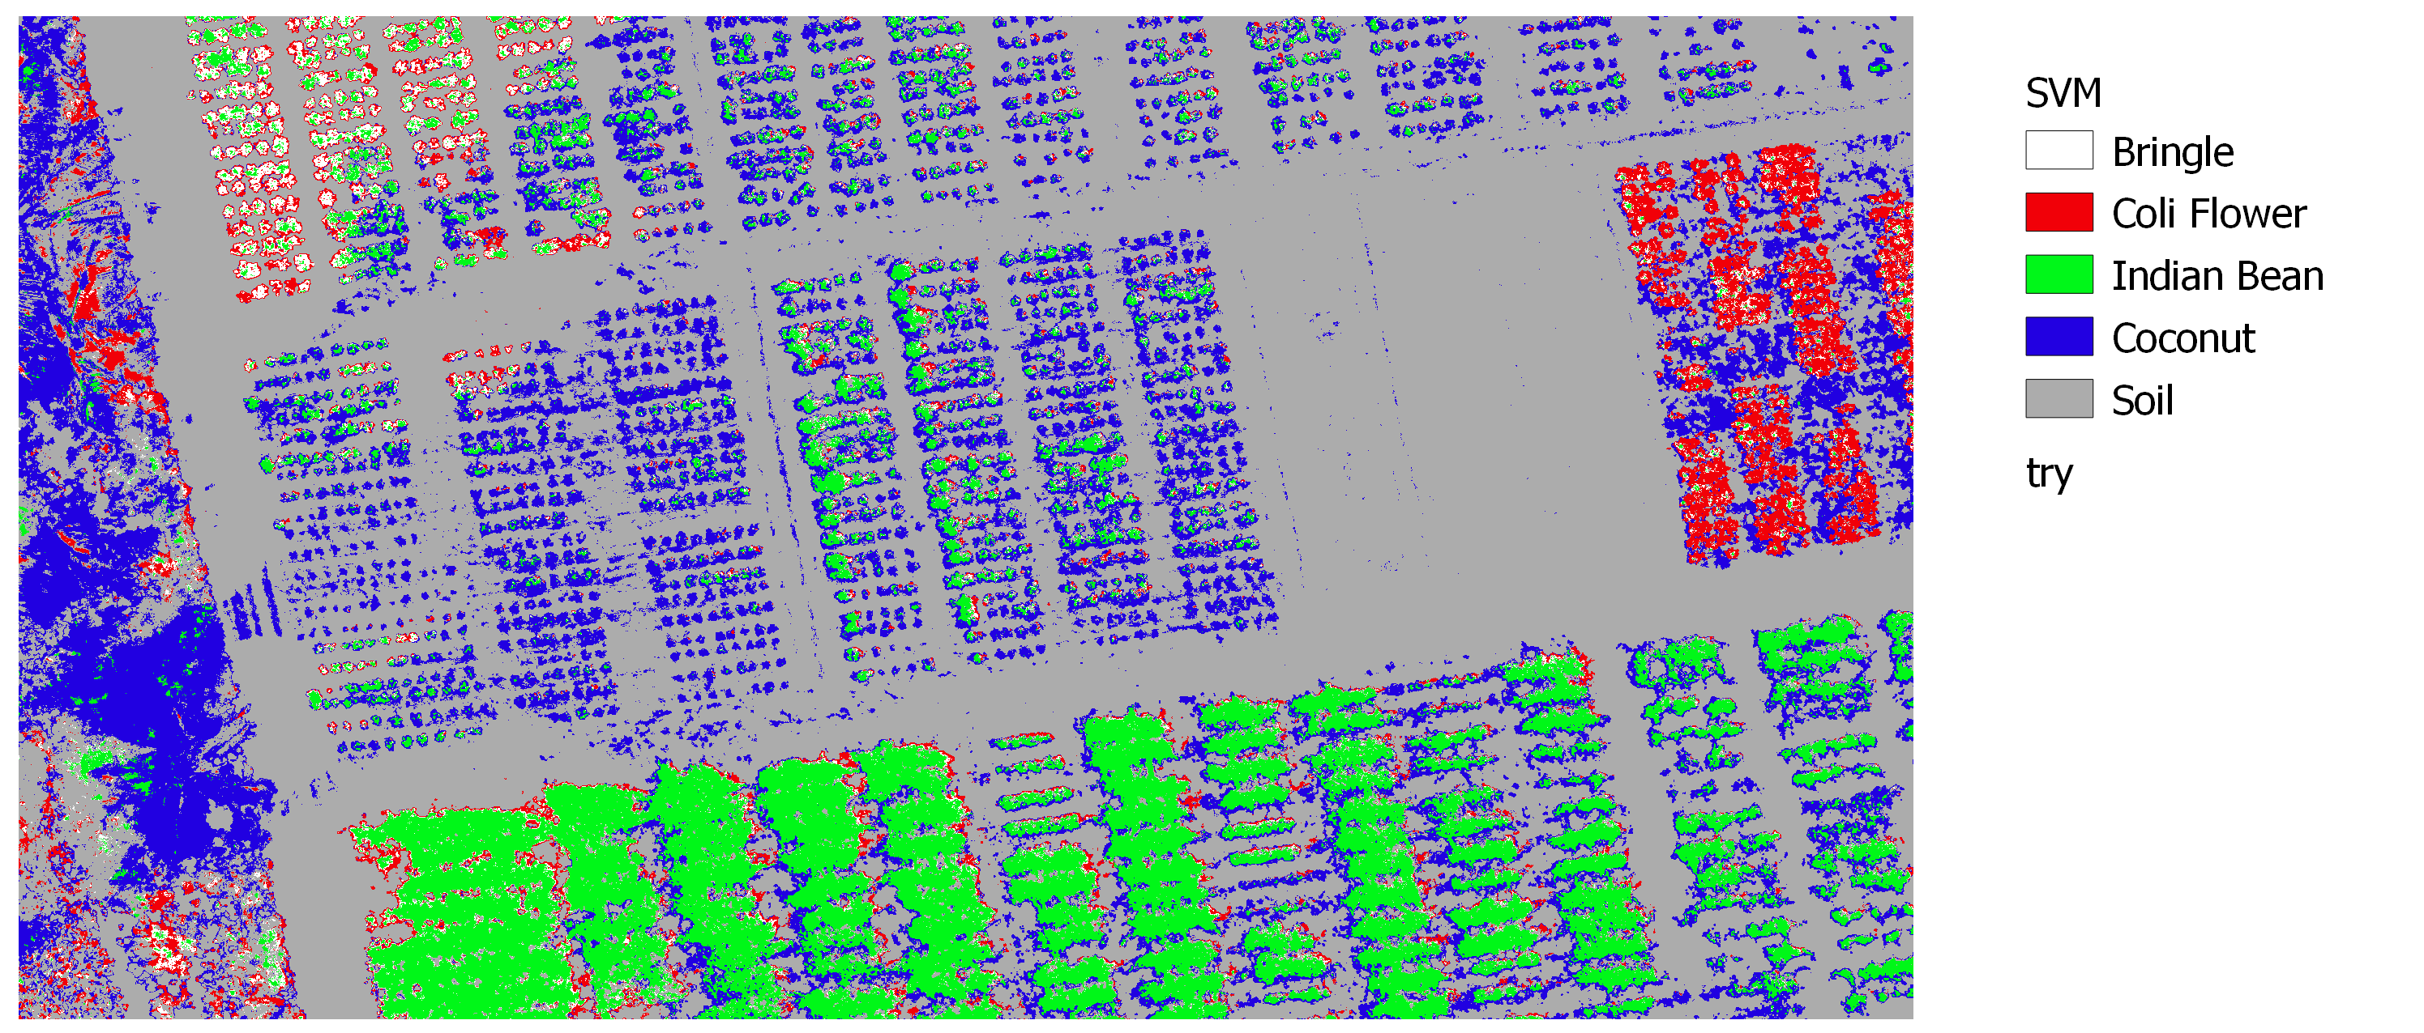
OUTPUT OF SVM CLASSIFIER
Classified RGB image using SVM

Slide 44
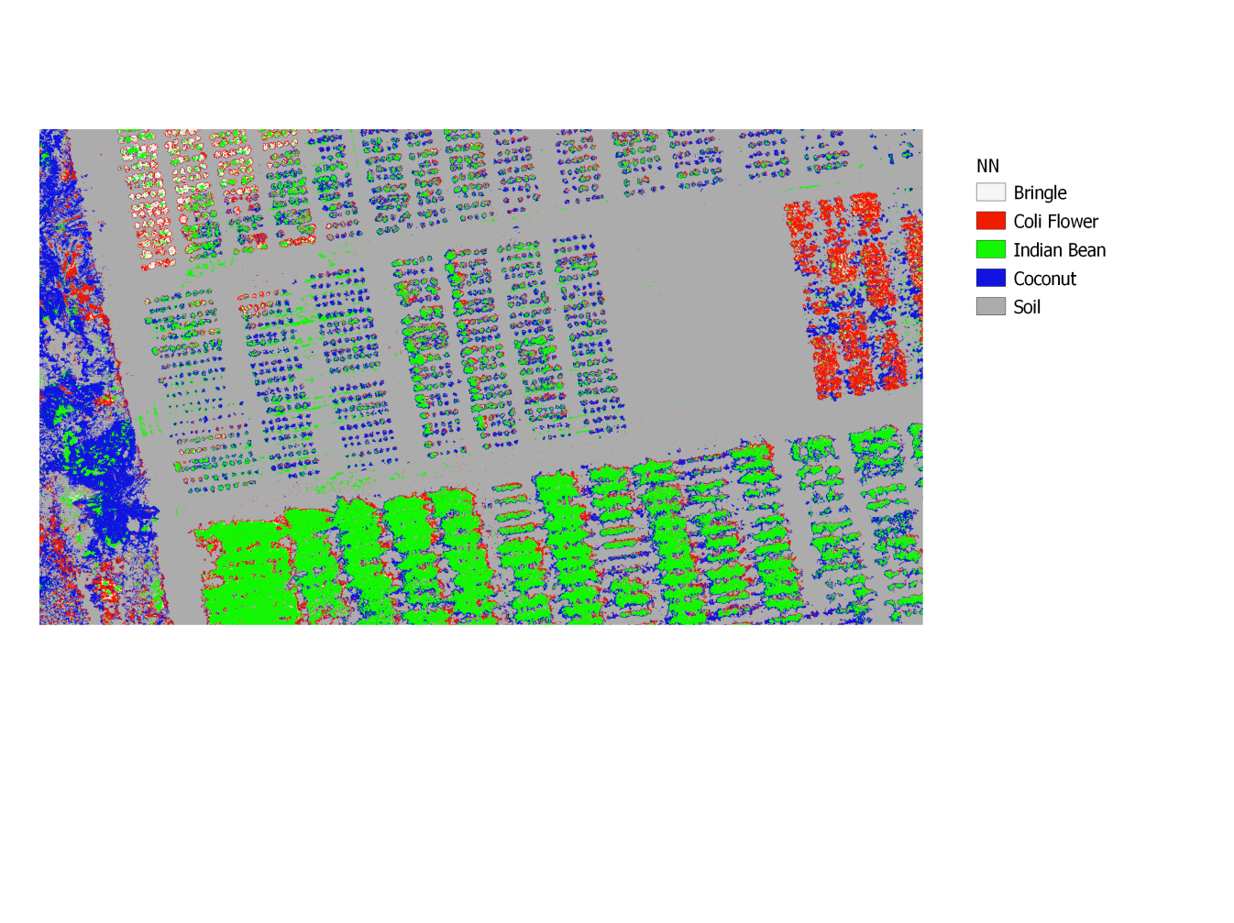
OUTPUT OF NN CLASSIFIER
Classified RGB image using ANN

Slide 45
CROP CLASSIFICATION
Comparison of SVM and ANN

Slide 46
06
Summary and Conclusion

Slide 47
Summary
Machine learning is a type of artificial intelligence (AI) that provides computers with the ability to learn without being explicitly programmed.
The proposed machine recommends the suitable crop condition given an image of the crop with parameters like latitude and longitude.
The system builds up an Image Classifier Model, using SVM and ANN, which acts as an image classifier builder to predict the crop class with improved accuracy.
This study explores the framework of crop identification by remote sensing and pursues the effective crop identification method.
This study is helpful in multicrop vegetative crop condition, to analyze the plant health and differentiate the different class of crop.

Slide 48
Conclusion
From above study it can be conclude that :-
UAV gives better Spatial resolution than Satellite imaginary
NDVI is most successful vegetative index for crop condition assessment
In this study very low values (0.1 and below) of NDVI correspond to barren areas of rock, sand or snow. Moderate values (0.2 to 0.3) represents shrub and grassland. High values (0.6 to 0.8) indicates healthy vegetation/crop
SVM gives better accuracy than NN to classify the crop among different classification model.
It may be said that there is a need for consistency, timely and reliable information sources t facilitate the analysis of crop vegetation.

Slide 49
07
References

Slide 50
Abhishek Kumar Maurya. (2011). Estimation of Acreage & Crop Production through Remote Sensing & GIS Technique. Geospatial world forum.
Anup K. Prasad, Lim Chai, Ramesh P. Singh, Menas Kafatos. (2006). Crop yield estimation model for Iowa using remote sensing and surface parameters. International Journal of Applied Earth Observation and Geoinformation 8 , 26–33.
C.-C. Yang, S.O. Prasher, J.-A. Landry, H.S. Ramaswamy. (2000). Application of artificial neural networks in image recognition and classification of crop and weeds. Canadian Biosystems Engineering / Le Genie des biosystems au Canada 42(3):147-152.
Congcong Li, Hongjun Li, Jiazhen Li, Yuping Lei, Chunqiang Li , Kiril Manevski, Yanjun Shen. (2019). Using NDVI percentiles to monitor real-time crop growth. Computers and Electronics in Agriculture 162 (2019) 357–363.
Glenn O. Biatwright, Victor S. Whitehead. (1986). Early Warning and Crop Condition Assessment Research. IEEE Transactions on Geoscience and Remote Sensing GE-24(1):54 – 64.
KarimEnnouri and Abdelaziz Kallel. (2019). Remote Sensing: An Advanced Technique for Crop Condition Assessment: Digital Research Centre of Sfax, Technopark of Sfax, Sfax, Tunisia. Mathematical Problems in Engineering, Volume 2019, Article ID 9404565.

Slide 51
Kenichi Tatsumi, Yosuke Yamashiki, Miguel Angel Canales Torres, Cayo Leonidas Ramos Taipe. (2015). Crop classification of upland fields using Random forest of time-series Landsat 7 ETM+ data. Computers and Electronics in Agriculture Volume 115, July 2015, Pages 171-179.
M. PAL and P. M. MATHER. (2004). Support vector machines for classification in remote sensing: School of Geography, University of Nottingham, UK. International Journal of Remote Sensing Vol.26, No.5,1007–1011
Md. Rejaur Rahman, A.H.M. Hedayutul Islam, Md. Ataur Rahman. (2004). NDVI Derived Sugarcane Area Identification and Crop Condition Assessment. Geography.
Meng Ji-hua and Wu Bing-fang. (2008). Study on the crop condition monitoring methods with remote sensing.
Miao Zhang, Bingfang Wu, Mingzhao Yu, Wentao Zou and Yang Zheng. (2014). Crop Condition Assessment with Adjusted NDVI Using the Uncropped Arable Land Ratio: Chinese Academy of Sciences, Olympic Village Science Park, W. Beichen Road, Beijing 100101, China. Remote Sensing, 2014, 6, 5774-5794.
Miss.Snehal S.Dahikar and Dr.Sandeep V.Rode. (2014). Agricultural Crop Yield Prediction Using Artificial Neural Network Approach. International journal of innovative research in electrical, electronics, instrumentation and control engineering, Vol. 2, Issue 1, January 2014

Slide 52
Mustafa Ustuner, Fusun Balik Sanli & Barnali Dixon. (2014). Application of Support Vector Machines for Landuse Classification Using High-Resolution RapidEye Images: A Sensitivity Analysis. European Journal of Remote Sensing - 2015, 48: 403-422.
Nataliia Kussul, Mykola Lavreniuk, Sergii Skakun, and Andrii Shelestov. (2017). Deep Learning Classification of Land Cover and Crop Types Using Remote Sensing Data. IEEE Geoscience and Remote Sensing LettersPP(99):1-5.
Paul C. Doraiswamy, Sophie Moulin, Paul W. Cook, and Alan Stern. (2003). Crop Yield Assessment from Remote Sensing. Photogrammetric Engineering and Remote Sensing, 69(6):665-674.
R. Poonguzhali, A.Vijayabhanu. (2019). Crop Condition Assessment using Machine Learning. International Journal of Recent Technology and Engineering (IJRTE), ISSN: 2277-3878, Volume-7 Issue-6S2.
R. S. Defries & J. R. G. Townshend. (2007). NDVI-derived land cover classifications at a global cale: Laboratory for Global Remote Sensing, Department of Geography, University of Maryland, College Park, Maryland, 20742, U.S.A. International Journal of Remote Sensing.
Rupali R. Surase, Karbhari V. Kale. (2015). Multiple Crop Classification Using Various Support Vector Machine Kernel Functions: Department of Computer Science & IT, DR. B.A.M.U. Aurangabad, INDIA. Rupali R. Surase Int. Journal of Engineering Research and Applications.

Slide 53
Shunping Ji, Chi Zhang, Anjian Xu, Yun Shi and Yulin Duan. (2018). 3D Convolutional Neural Networks for Crop Classification with Multi-Temporal Remote Sensing Images. Remote Sensing.
Wei Shen, Mu Zhou, Feng Yang, Dongdong Yu, Di Dong, Caiyun Yang, Yali Zang, Jie Tian. (2016). Multi- crop Convolutional Neural Networks for lung nodule malignancy suspiciousness classification: Beijing Key Laboratory of Molecular Imaging, Beijing 100190, China. Pattern Recognition, Volume 61, January 2017, Pages 663-673.
Zhang Fumin, Zhu Zaichun, Pan Yaozhong, Hu Tangao, Zhang Jinshui. (2010). Application of remote sensing technology in crop acreage and yield statistical survey in china. Data Management Center of National Bureau of Statistics of China.

Slide 54
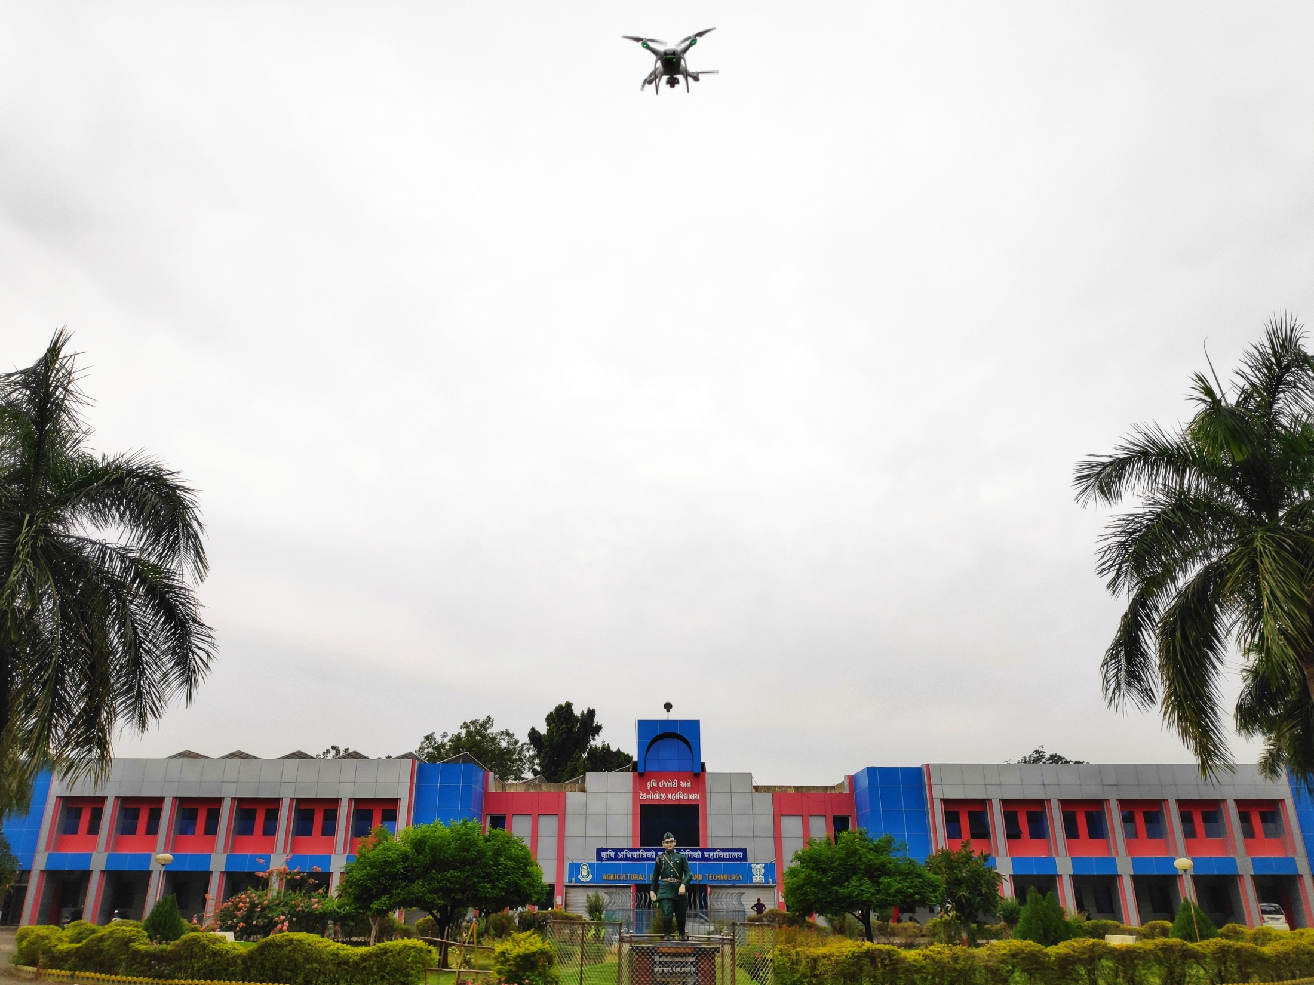
THANK YOU..!!

